Slide 1

72A, B Block, Near Vinci Public School, Kakrola More,
Dwarka More, New Delhi-78

Slide 2
Even Today, Signages, Branding (Indoor and Outdoor) and Retail Advertising remain to be the strongest and most effective forms of offline communication.
“Great advertising helps you reach out and
get noticed by millions.”
DIGITAL FRY | Company profile | 2019

Slide 3
ABOUT US
DIGITAL FRY is a full-service visual branding agency started in 2005. Since our inception, we’ve created Signage Ideas, Designer Signages, Retail Branding, Indoor & Outdoor Branding, Novelties, Exhibition Design and Art & Crafts that have created memorable brands. Our clients span industries like Ad Agencies, Corporate Houses, Real Estate, Retail Outlets, Architects and Interior Designers along with Local & Street Markets. Each of our client has given us the opportunity to create great designs that have turned into beautiful pieces of execution. And we’ve managed to deliver with perfection on time, each time.
DIGITAL FRY | Company profile | 2019

Slide 4
OUR EXPERTISE
INDOOR
Ultra slim backlit signage
Clipon signage
Customise signage's
- Copper
- Brass
- Steel
- Acrylic
- MDF
Sandwich poster (lit/nonlit)
Graphics for wall and floor
Reception signage
Promotional materials
Way finder
Glass film
Safety sign
OUT DOOR
ACP cladding
Main signage's
LED signage
3D letter signage
Lollipop signage
Hoarding structure
Vehicle branding
RETAIL
Retail Interior
Retail outlet makeover
Retail brand backdrop display
Retail display stands, showcase design and execution
Retail dealer branding
ADVERTISING MEDIA
Corporate Design
Advertising promotional design
Packaging
NOVELTIES
Design & production
EXHIBITIONS
Design & execution
ART & CRAFT
Handicraft
DIGITAL FRY | Company profile | 2019

Slide 5
OUR STRENGTH
We have HP5500ps hi-resolution digital printing machine and Eco Valuejet with hi-resolution solvent printing machines.
We have wooden, acrylic display & signage manufacturing unit.
DIGITAL FRY | Company profile | 2019

Slide 6
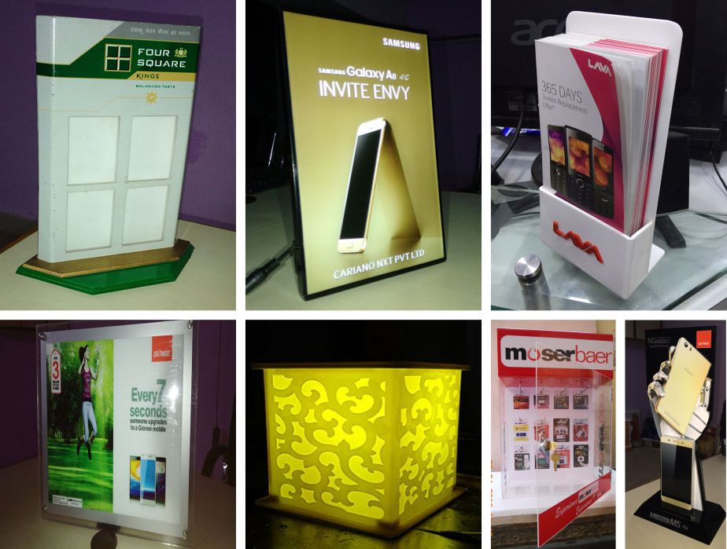
Acrylic Promotional Novelties
DIGITAL FRY | Company profile | 2019

Slide 7
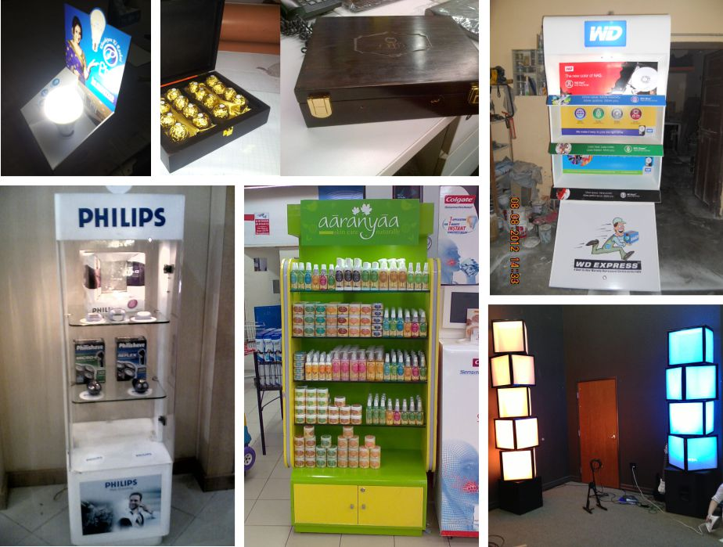
Promotional Novelties/Display Stand
DIGITAL FRY | Company profile | 2019

Slide 8
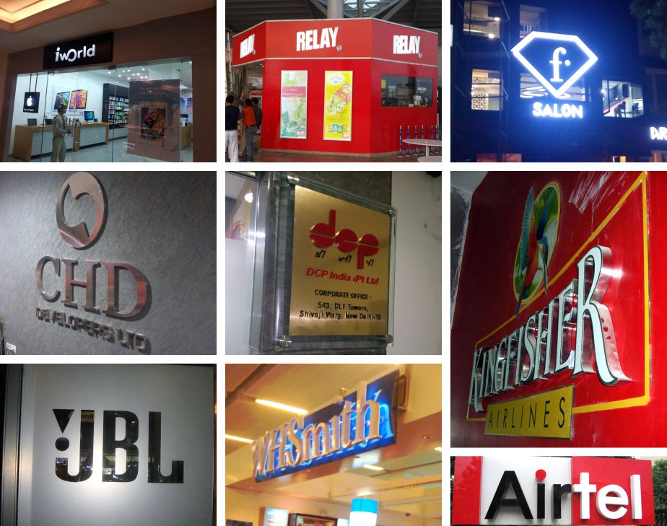
Branding on Facade
DIGITAL FRY | Company profile | 2019

Slide 9
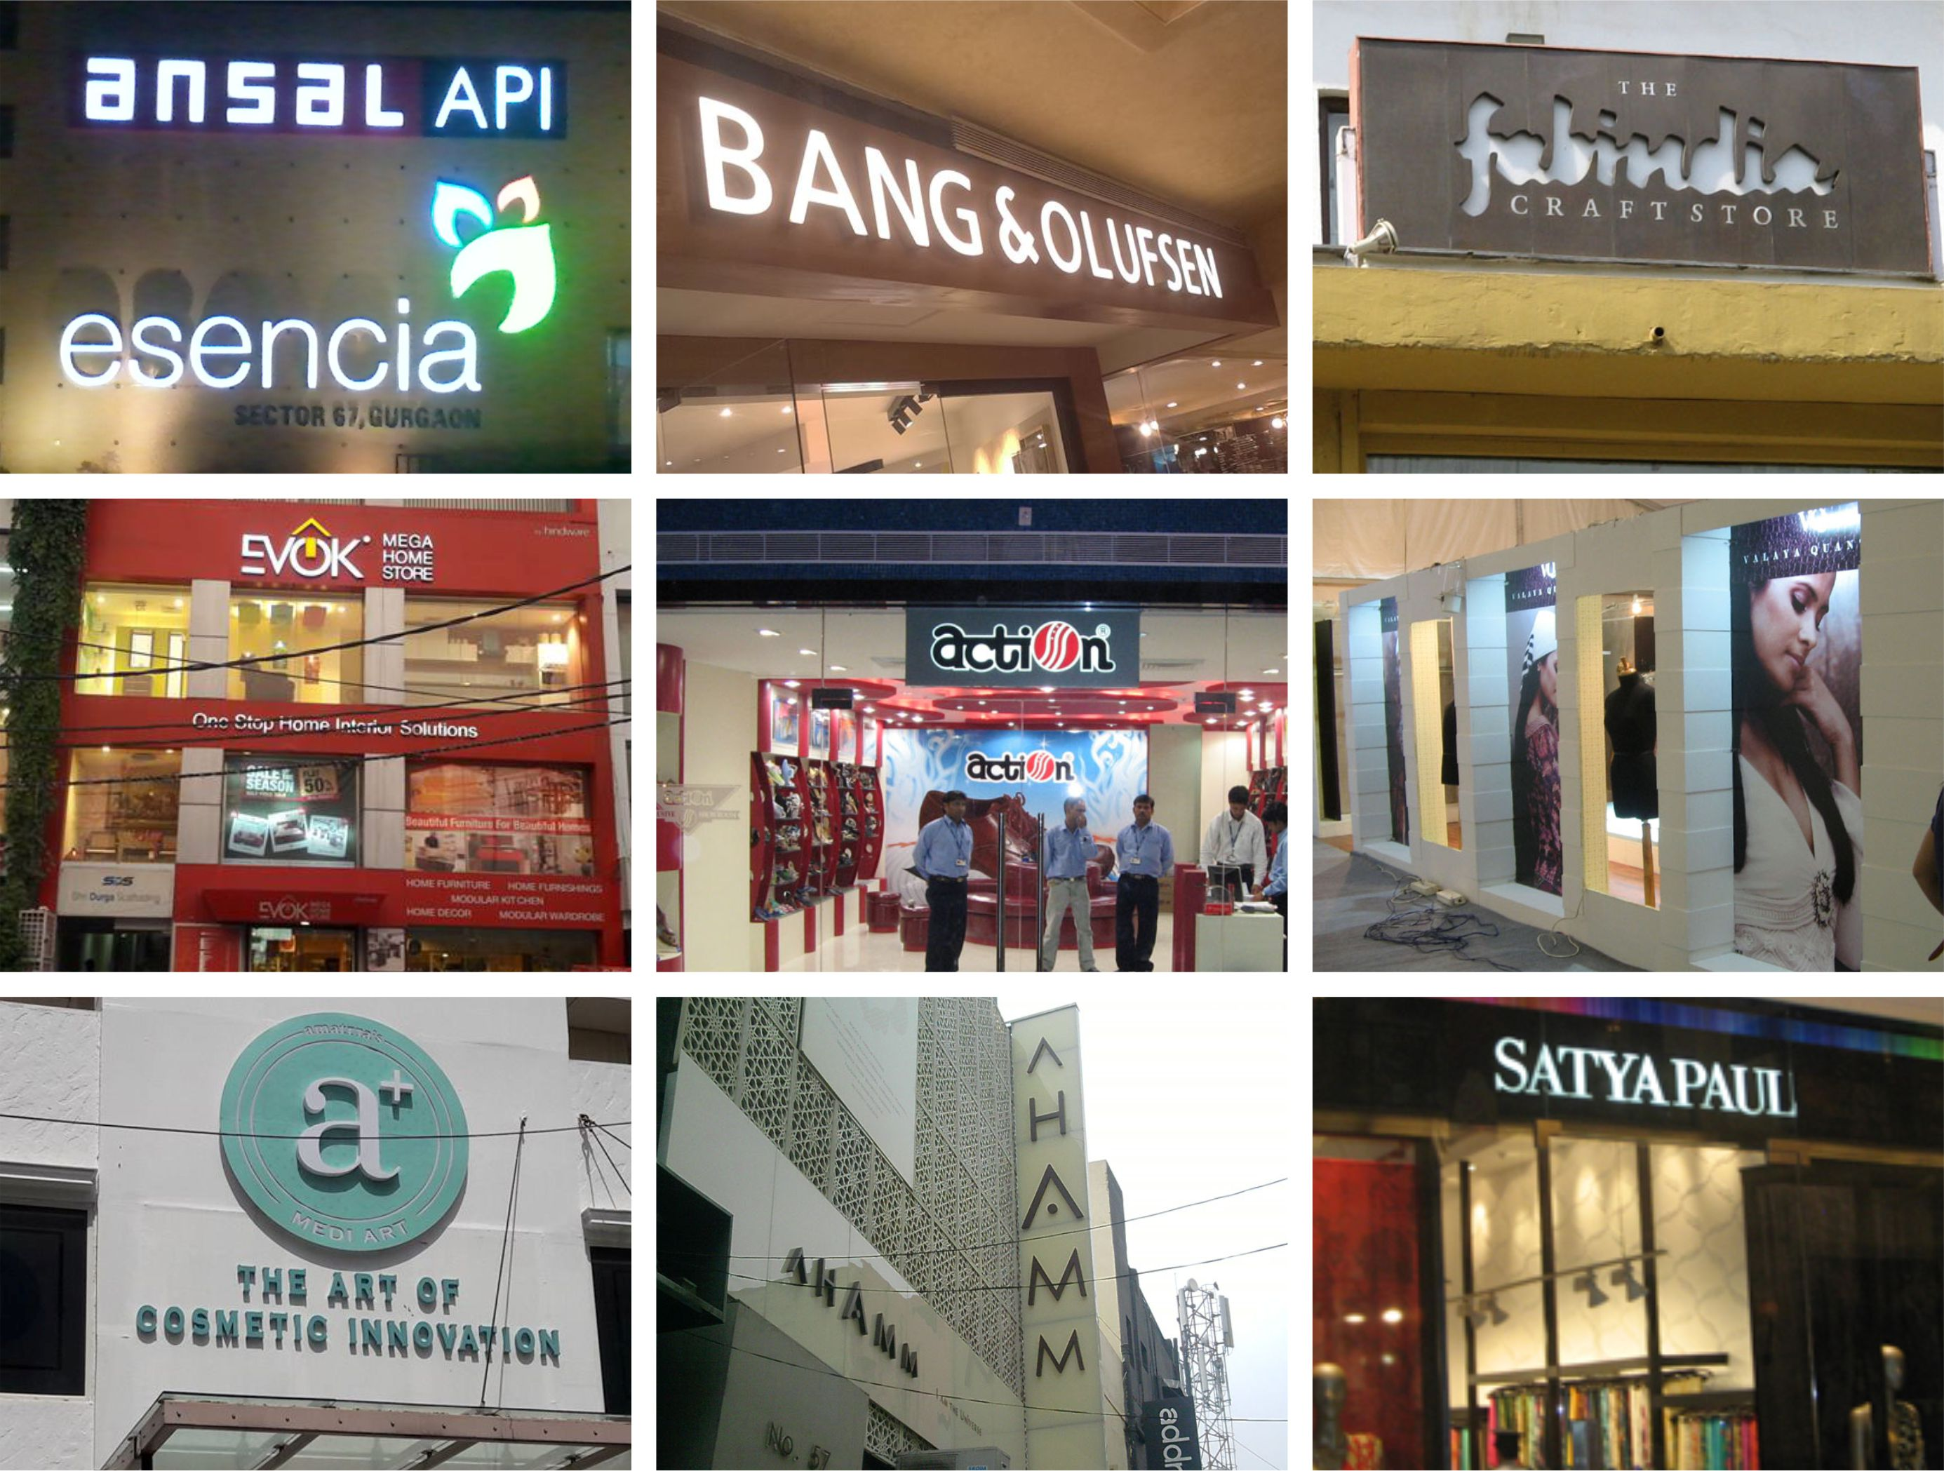
Branding on Facade
DIGITAL FRY | Company profile | 2019

Slide 10
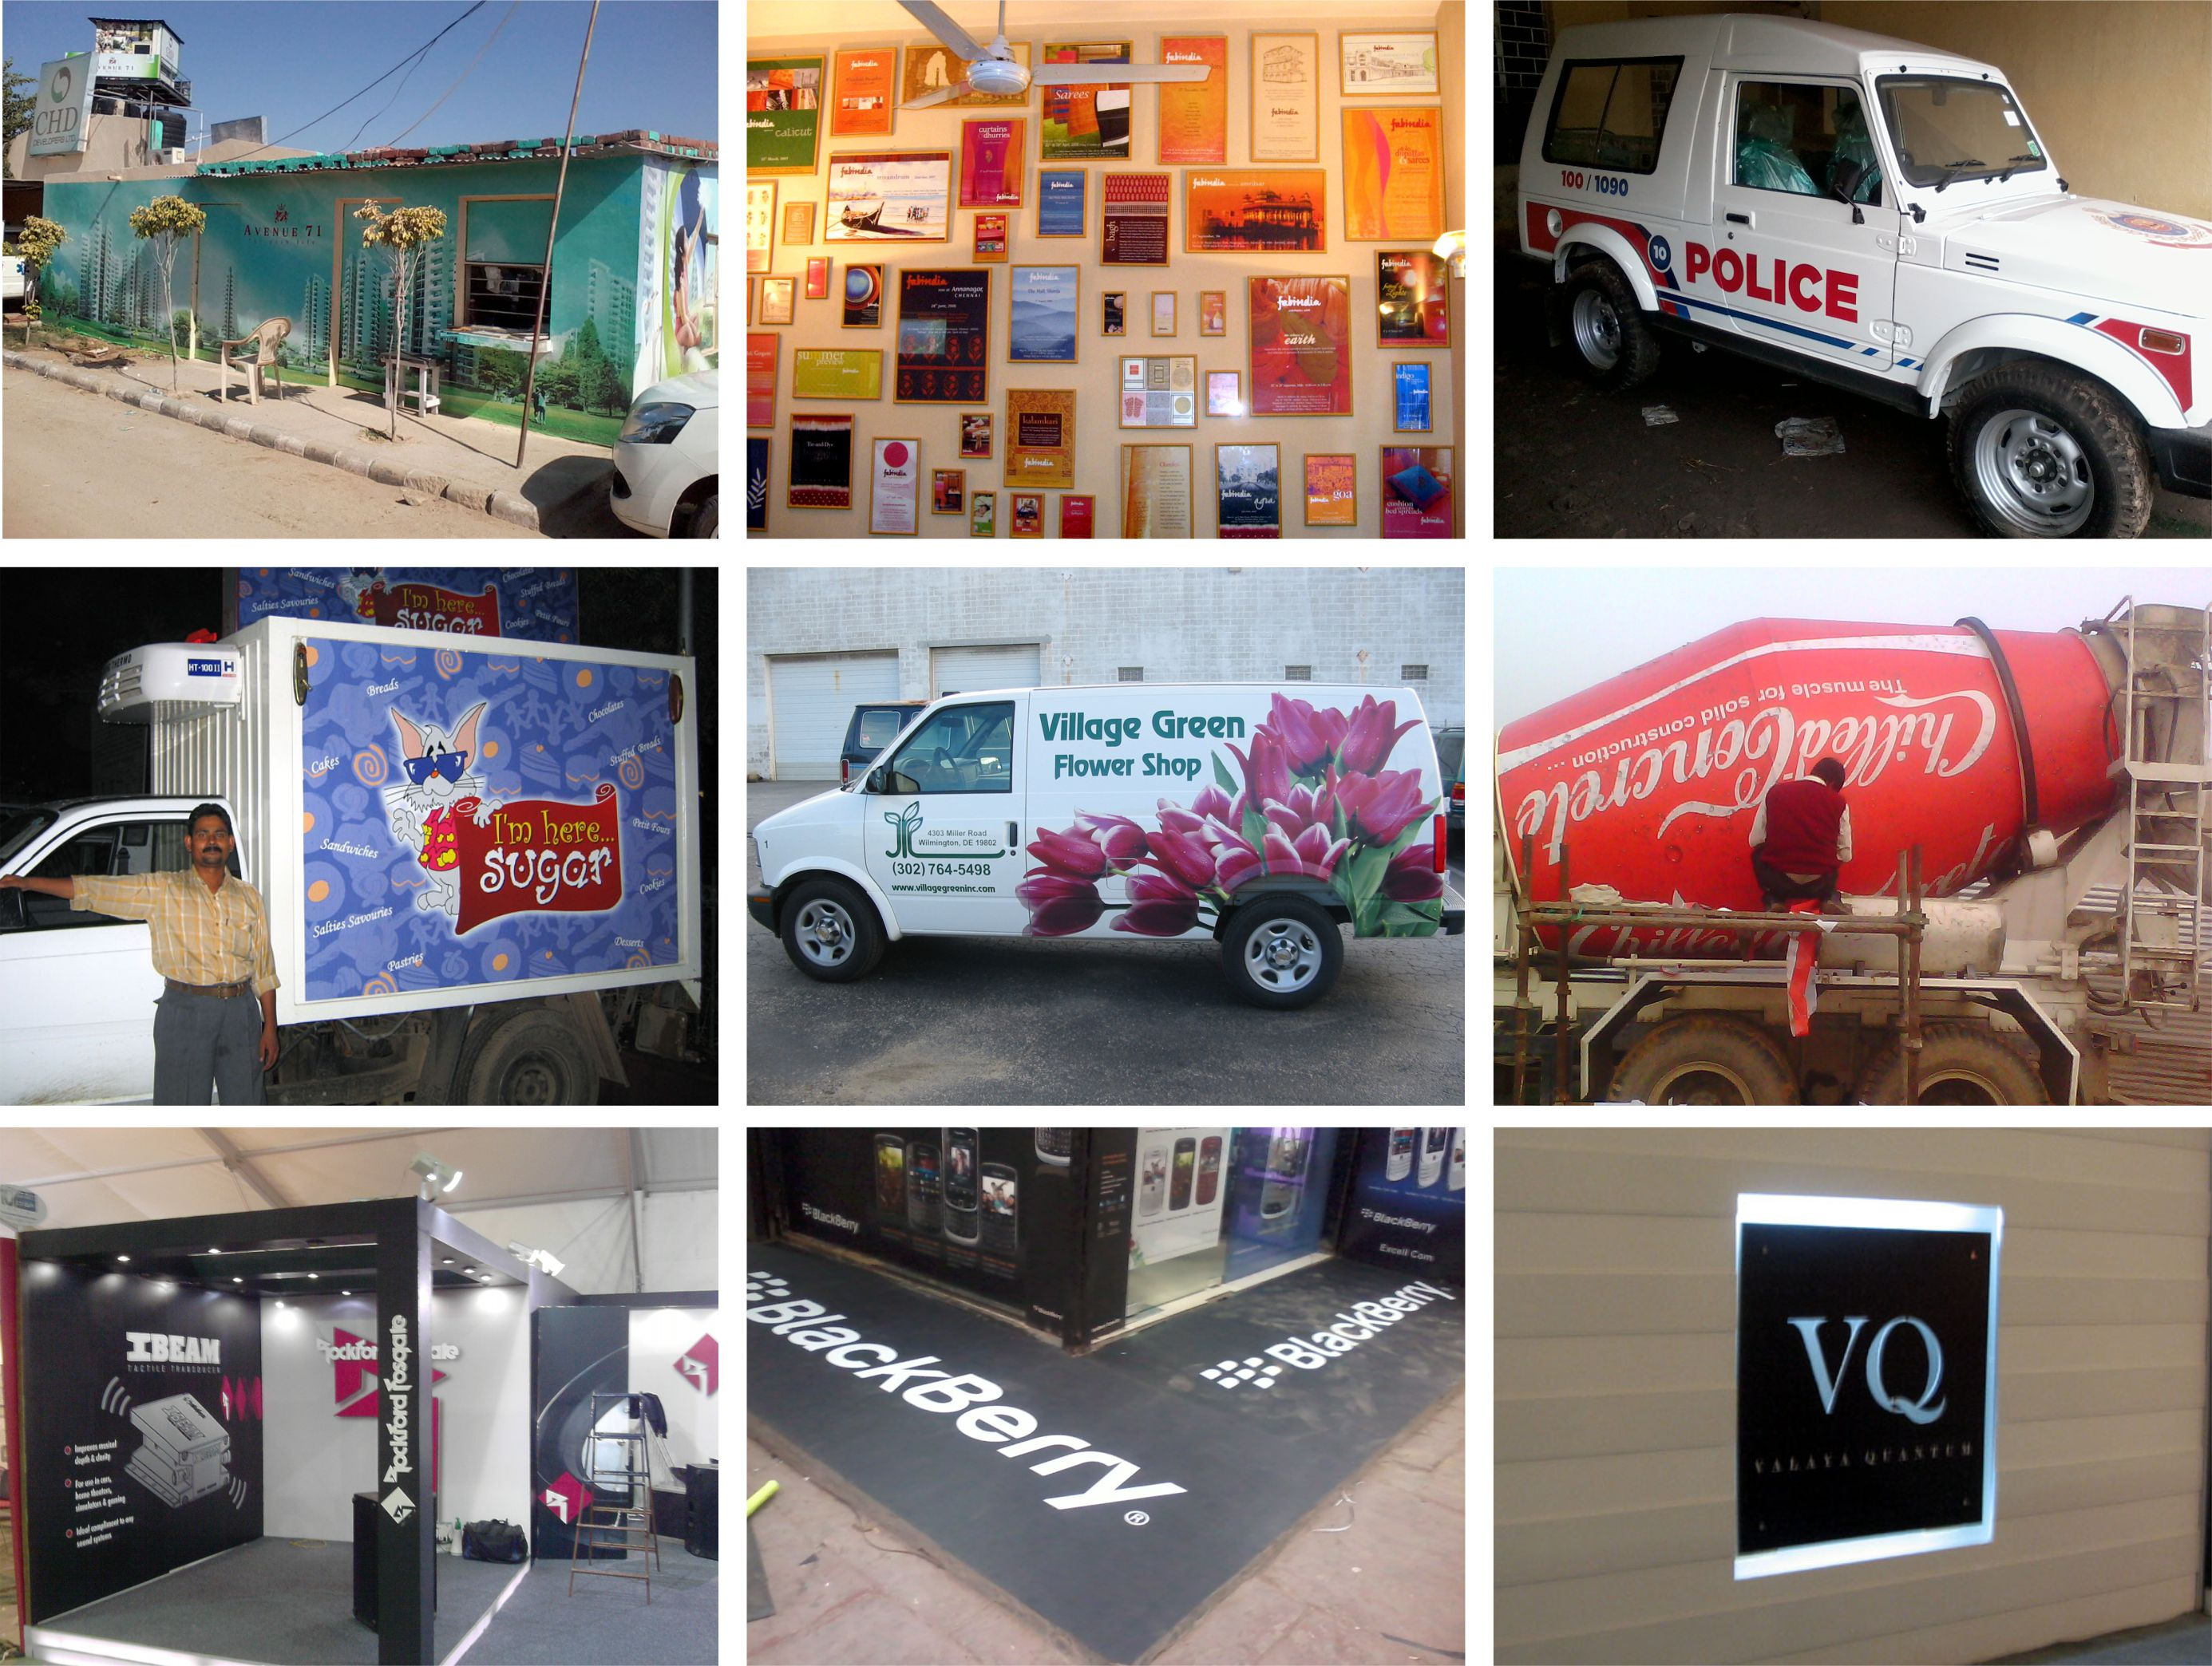
Printing
DIGITAL FRY | Company profile | 2019

Slide 11
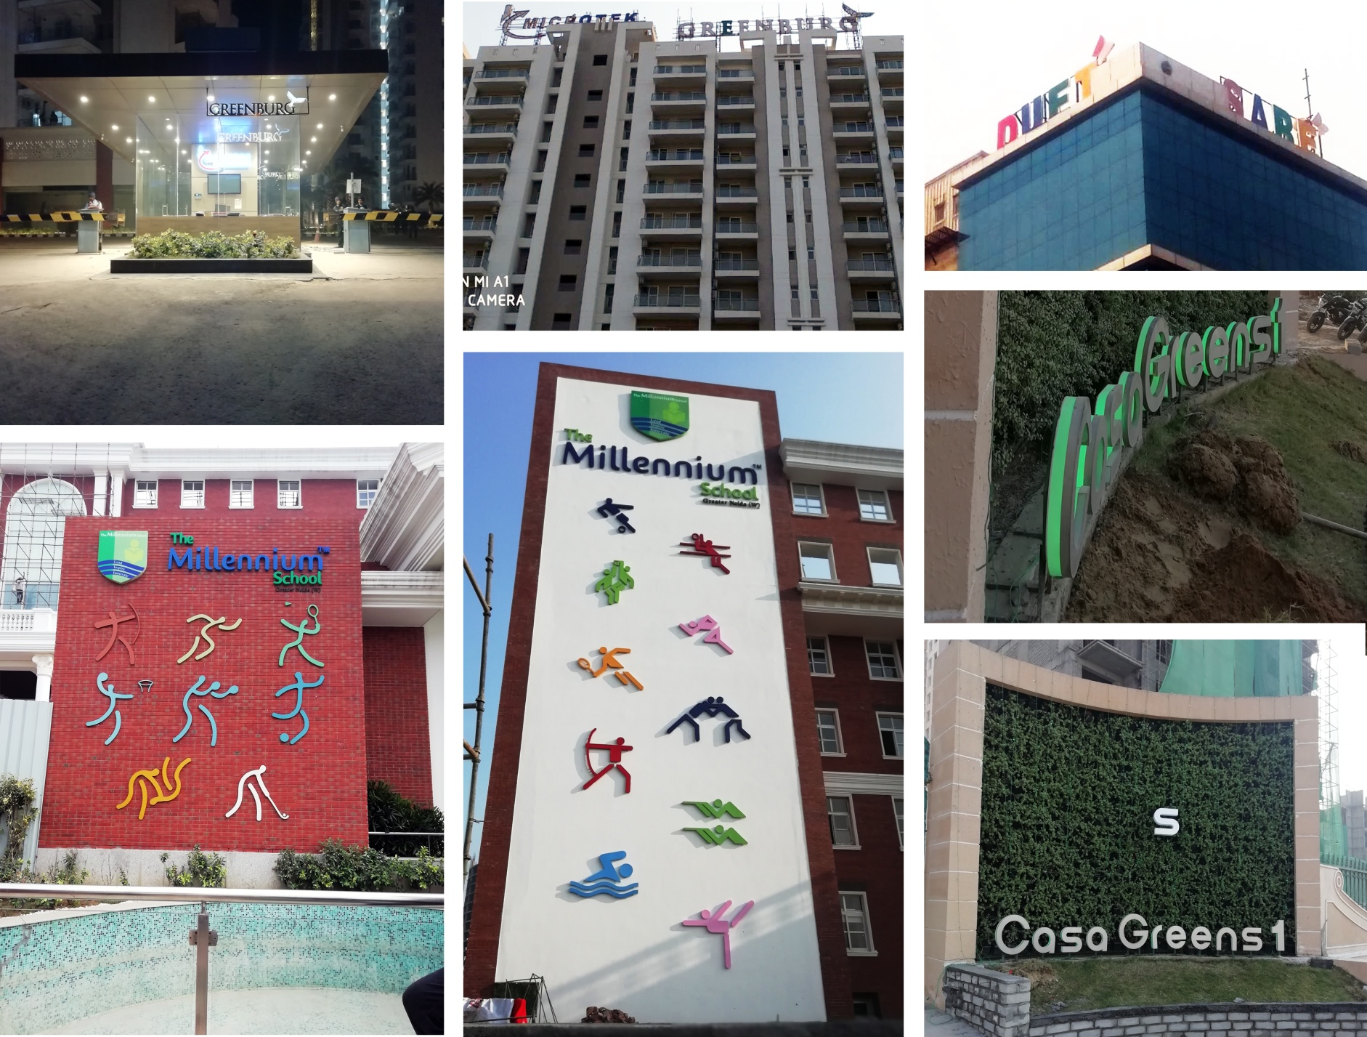
Building Signages
DIGITAL FRY | Company profile | 2019

Slide 12
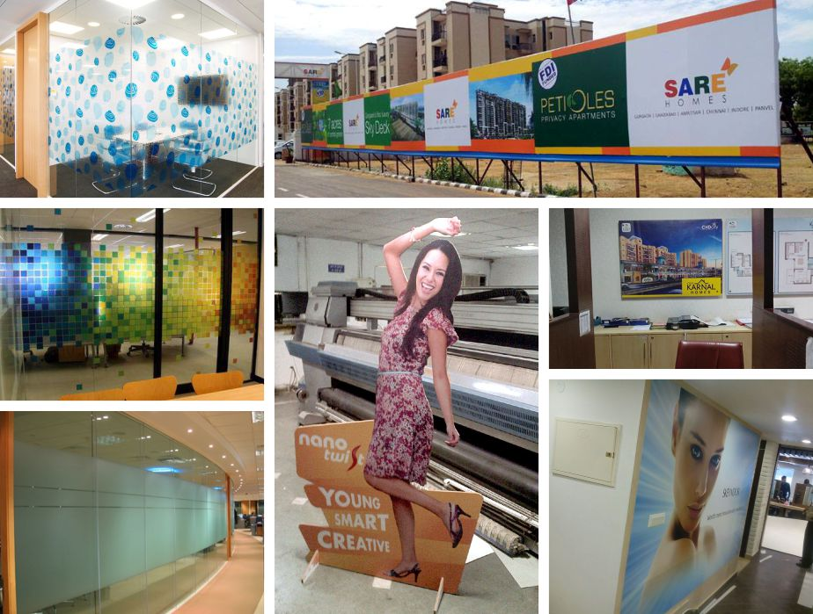
Glass Films / Barricade / Printing

Slide 13
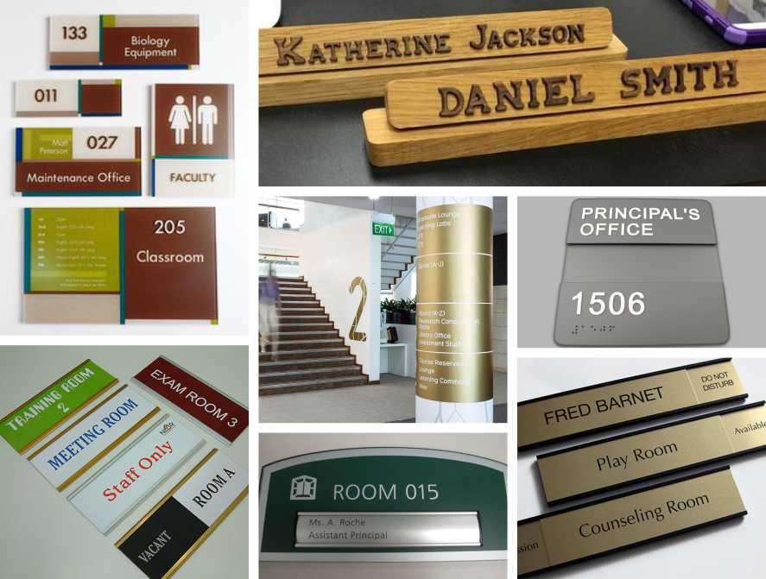
Informative Signage
DIGITAL FRY | Company profile | 2019

Slide 14
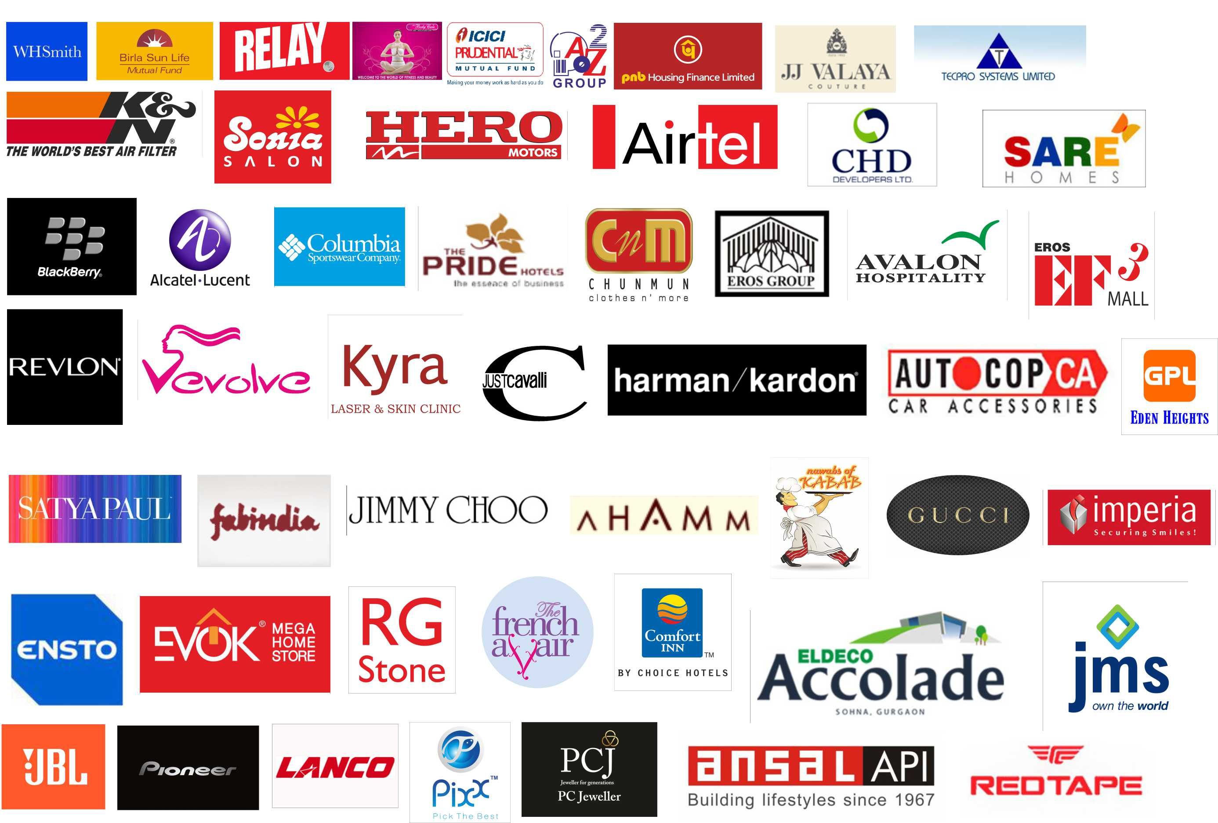
Our Clients
DIGITAL FRY | Company profile | 2019

Slide 15
Thank You
Contact : mkt.digitalfry@gmail.com | sales.digitalfry@gmail.com | svs.digitalfry@gmail.com
DIGITAL FRY | Company profile | 2019

